Slide 1
Intro to MongoDB

Slide 2
Objectives
What is MongoDB?
Functionality of MongoDB
Why MongoDB?
MongoDB: CAP Approach
MongoDB: Hierarchical Objects
Design of MongoDB
Installing MongoDB on Windows/Mac/Linux

Slide 3
What is MongoDB?
MongoDB is an open-source document-oriented database that is designed to store a large scale of data and allows you to work with that data very efficiently.
Instead of using tables and rows as in the traditional relational databases, MongoDB makes use of Collections & documents.
Documents consist of key-value pairs which are the basic unit data in MongoDB.
Collections contain set of documents which is equivalent to tables in Relational databases.

Slide 4
What is MongoDB?
It also provides official driver support for all the popular languages like C, C++, C#, and .Net, Go, Java, Node.js, Perl, PHP, Python, Motor, Ruby, Scala, Swift, Mongoid. So, that you can create an application using any of these languages.
Nowadays there are so many companies that used MongoDB like Facebook, Nokia, eBay, Adobe, Google, etc. to store their large amount of data.

Slide 5
MongoDB vs RDBMS
RDBMS | MongoDB
Database | Database
Table | Collection
Tuple/Row | Document
Column | Field
Table Join | Embedded Documents
Primary Key | Primary Key (Default key provided by it)

Slide 6
Features of MongoDB
Each database contains collections which in turn contains documents. Each document can be different with a varying number of fields. The size and content of each document can be different from each other.
The document structure is more in line with how developers construct their classes and objects in their respective programming languages. Developers will often say that their classes are rows are columns but have a clear structure with key-value pairs.
The rows (or documents in MongoDB) doesn’t need to have a schema defined beforehand. Instead, the fields can be created on the fly.
The data model available within MongoDB allows you to represent hierarchical relationships to store arrays, and other more complex structures more easily.

Slide 7
Key Components of MongoDB Architecture
_id – This is a field required in every MongoDB document. The _id field represents a unique value in the MongoDB document. The _id field is like the document’s primary key.
Collection – This is a grouping of MongoDB documents. A collection is equivalent of a table which is created un any other RDBMS such as MYSQL.
Cursor – is a pointer to the result of a query. Clients can iterate through a cursor to retrieve results.
Database – is a container for collections like RDMS wherein it is a container for tables.
Document – is a record in a MongoDB collection. Document in turn, will consist of field name & values.
JSON – is known as JavaScript Object Notation. This is human-readable, plain text format for expressing structured data.

Slide 8
Key Components of MongoDB Architecture
Document-oriented – Since MongoDB is a NoSQL database, instead of having data in a relational type format, it stored the data in documents. This makes MongoDB very flexible and adaptable to real business world situation and requirement.
Replication – MongoDB can provide high availability with replica sets
Indexing – Indexes can be created to improve the performance of searches within MongoDB.
Load Balancing – MongoDB uses the concept of sharding to scale the data horizontally by splitting data across MongoDB instances. MongoDB can run over multiple servers, balancing the load and/or duplicating data to keep the system up and running in case of hardware failure.

Slide 9
MongoDB: CAP Approach
Relative to the CAP theorem, MongoDB is a CP data store – it resolves network partitions by maintaining consistency, while compromising on availability.
MongoDB is strongly consistently by default – if you do a write and then do a read, assuming the write as successful you will always be able to read the result of the last write. This is because MongoDB is a single-master system, and all reads go to the primary by default.
When the primary node becomes unavailable, the secondary node with the most recent operation log will be elected as the new primary node(master).

Slide 10
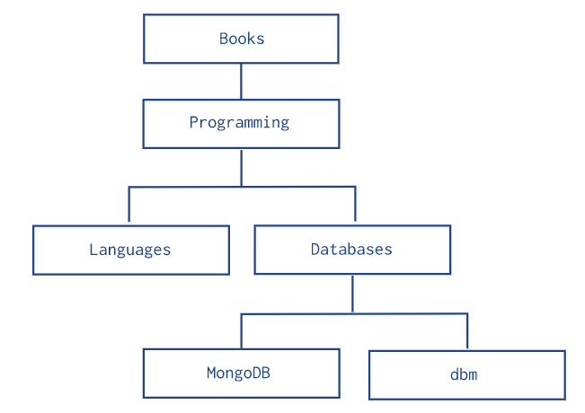
MongoDB: Hierarchical Objects

Slide 11
MongoDB: Hierarchical Objects
MongoDB allows various ways to use tree data structures to model large hierarchical or nested relationships –
Model Tree Structure with Parent References – Stores each tree node in a document; in addition to the tree node, the document stores the _id of the node's parent.
Model Tree Structures with Child References – Stores each tree node in a document; in addition to the tree node, document stores in an array the id(s) of the node's children.
Model Tree Structure with an Array of Ancestors – Stores each tree node in a document; in addition to the tree node, document stores in an array the id(s) of the node's ancestors or path
Model Tree structure with Materialized Paths – Stores full relationship paths between documents.

Slide 12
MongoDB Design
Now, MongoDB schema design works a lot differently than relational schema design. With MongoDB schema design, there is:
No formal process
No algorithms
No rules
When you are designing your MongoDB schema design, the only thing that matters is that you design a schema that will work well for your application.

Slide 13
Embedding vs. Referencing
MongoDB schema design actually comes down to only two choices for every piece of data.
Embedding
Advantages
You can retrieve all relevant information in a single query.
Avoid implementing joins in application code or using $lookup
Disadvantages
Large documents mean more overhead if most fields are not relevant. You can increase query performance by limiting the size of the documents that you are sending over the wire for each query.
There is a 16-MB document size limit in MongoDB. If you are embedding too much data inside a single document, you could potentially hit this limit.

Slide 14
Embedding vs. Referencing
Referencing – It’s referencing another document using a document's unique object _id and connecting them together using the $lookup operator.
Advantages
By splitting up data, you will have smaller documents.
Less likely to reach 16-MB-per-document limit
Infrequently accessed information not needed on every query.
Reduce the amount of duplication of data. However, it's important to note that data duplication should not be avoided if it results in a better schema.
Disadvantages
In order to retrieve all the data in the referenced documents, a minimum of two queries or $lookup required to retrieve all the information.

Slide 15
Let’s now see the
MongoDB installation!

